Slide 1
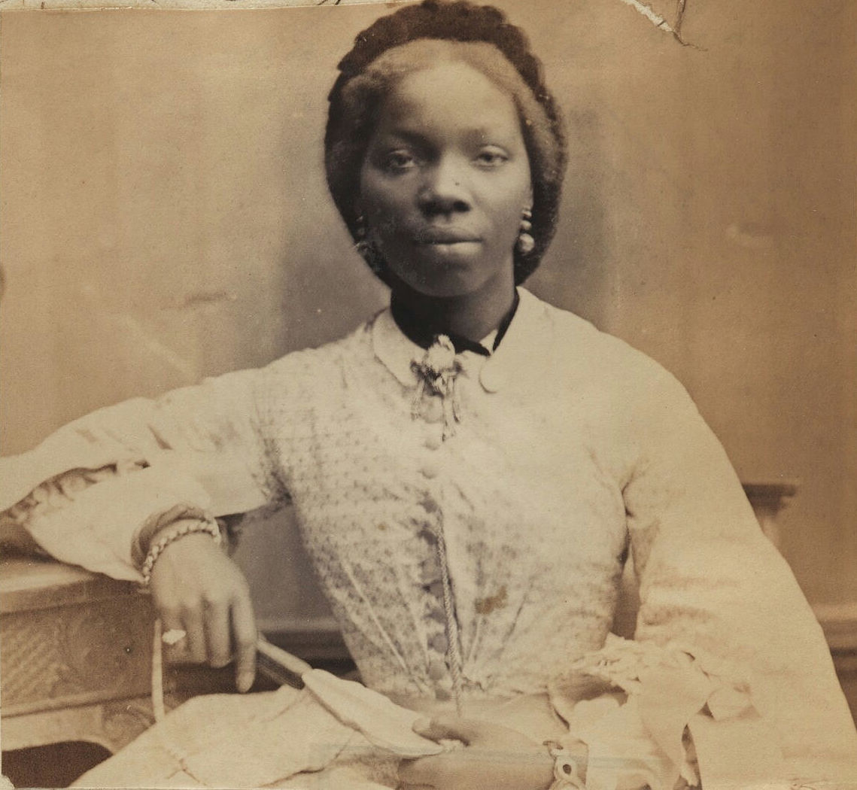
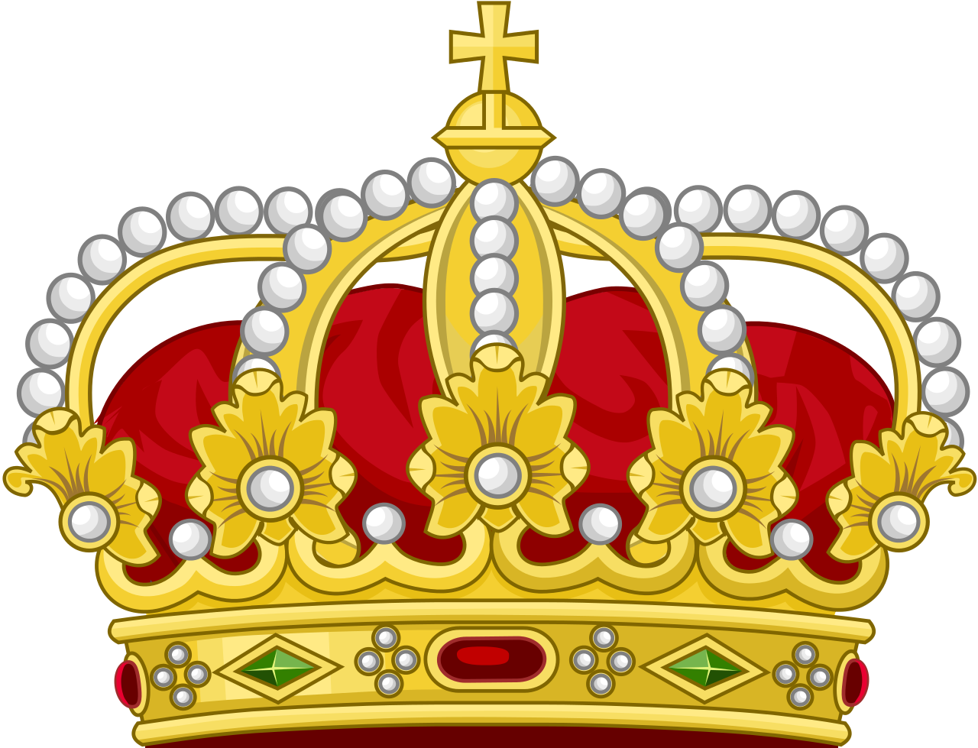
Sarah Forbes-Bonetta
An African Princess

Slide 2
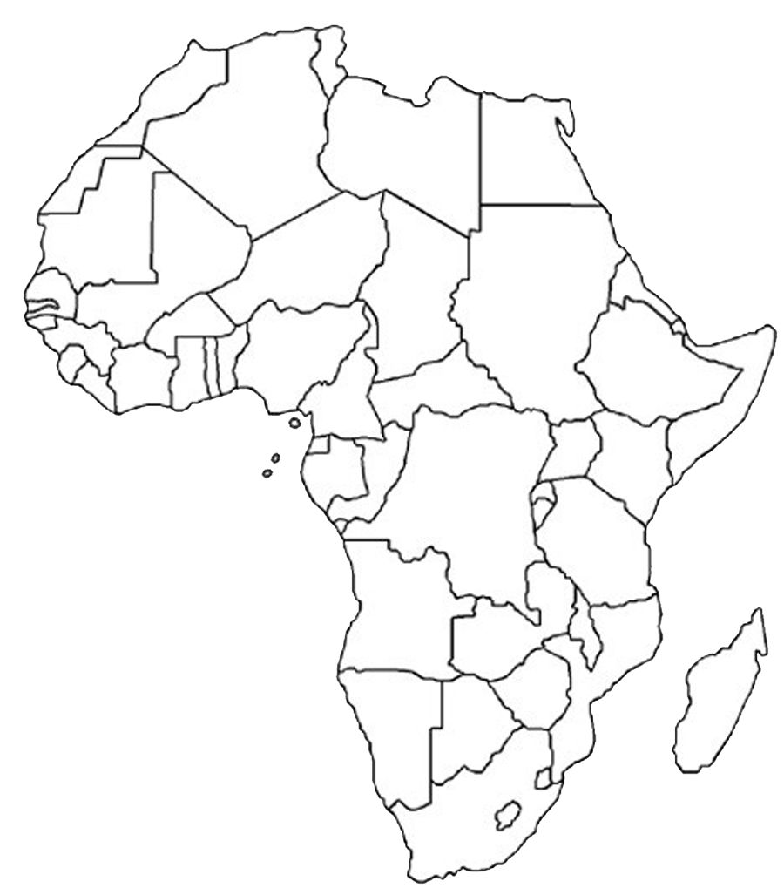
Label the map
Match the land area to the name of the country in Africa.
Nigeria
Cameroon
Central African Republic
People who have made a positive change

Slide 3
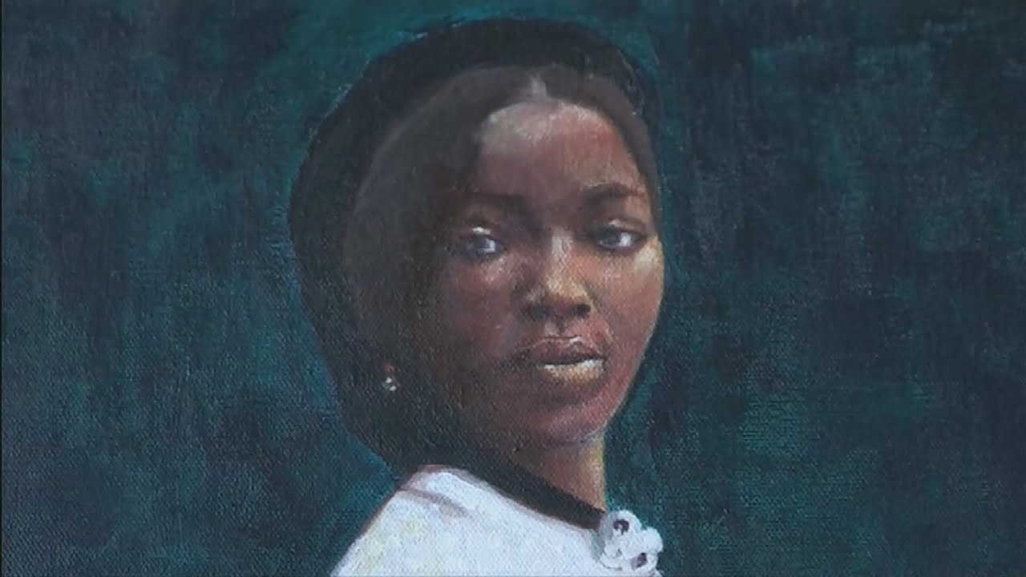
Who is Sarah Forbes-Bonetta?
Sarah Forbes-Bonetta was a Nigerian Princess born Omoba Aina in Yewa State in Southern Nigeria in 1843.
In 1848, her Kingdom was invaded by a rival army and young Sarah was captured and taken as a slave by King Ghezo of Dahomey.
In an incredible turn of events she was freed by Captain Frederick E Forbes, a British Naval officer, who was in Dahomey to negotiate the end of their part in the slave trade. Sarah was “offered” as a “gift” and Frederick E Forbes accepted Sarah on behalf of Queen Victoria.
When Sarah arrived in Britain, she met Queen Victoria. The Queen was so impressed by Sarah’s intellect and charm that she took her as her Goddaughter and had her raised as a member of the British upper middle class.
People who have made a positive change

Slide 4
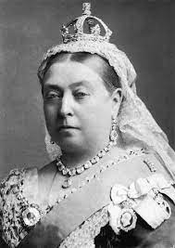
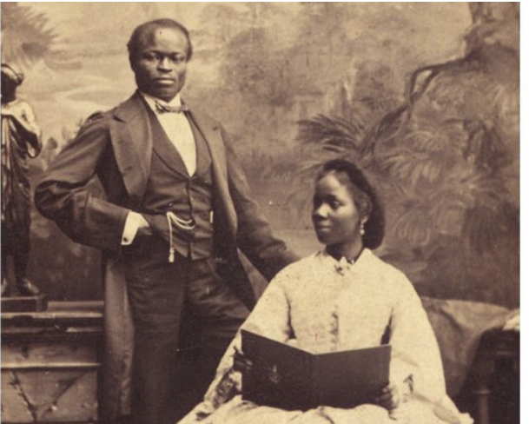
Who is Sarah Forbes-Bonetta?
Queen Victoria who reigned as monarch for 63 years over saw a period of huge industrial, scientific and political change in Britain. This was known as the Victorian era and until recently, little was taught about the contribution of black people in this important period of British history.
Sarah Forbes became the Goddaughter of Queen Victoria which means she lived a relatively privileged life. She attended Grammar schools in England and Sierra Leone before marrying a wealthy Nigerian business man called James Pinson Labulo Davies.
How might Sarah’s life been different to the average person in Victorian Britain?
People who have made a positive change

Slide 5
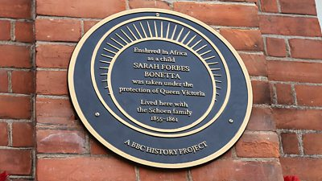
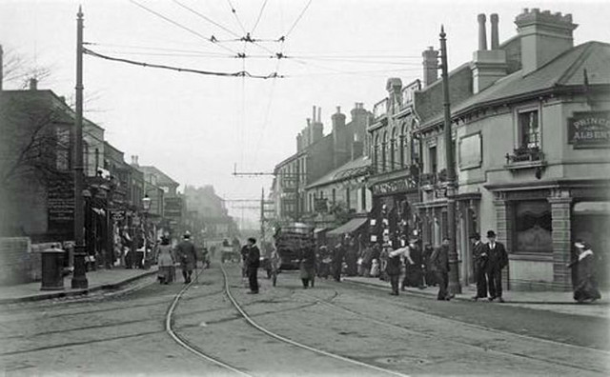
The Kent Connection
Sarah Forbes-Bonetta returned from school in Sierra Leone in 1955 aged 12 where she lived at Palm Cottage, Canterbury Street, Gillingham with Reverend Frederick Scheon and his wife. The house still survives today!
Activity – Ask your parents and guardians to take you there for a look at Kentish Black history!
People who have made a positive change

Slide 6
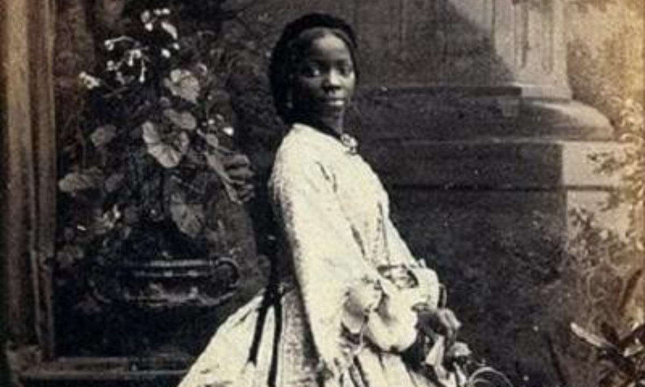
What we know about Sarah
She was born into Nigerian Royalty
She was captured during a war and enslaved aged 5
Liberated from slavery by a Naval officer
Travelled to England and met Queen Victoria in 1850
Educated in Freetown Sierra Leone, she was known for her intellect
She lived in Gillingham, Kent as a teenager
Married James Pinson Labulo Davies in 1862
Had 3 children called Victoria, Arthur and Stella
People who have made a positive change
Died in Madeira, Portugal in 1880 aged 37

Slide 7
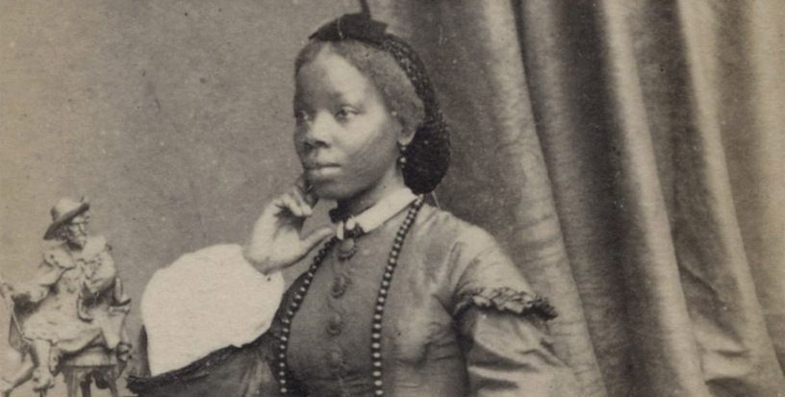
Activity Time
Why did Sarah, a Nigerian princess, find herself living in Britain?
Why did Queen Victoria take such a strong liking to Sarah?
What aspects of Sarah’s life did you find most interesting?
How would life have been different for black people living in Victorian era Britain?
How would Sarah’s status as a Goddaughter to Queen Victoria have impacted her life?
People who have made a positive change

Slide 8
Answer Sheet 1
Match the land area to the name of the country in Africa.
Nigeria
Cameroon
Central African Republic
People who have made a positive change

Slide 9
Answer Sheet 2
How would life have been different for black people living in Victorian era Britain?
Black people in Victorian ere Britain were a rarity so would have been treated with curiosity by some and hostility by others. Most black people would have been working class, with average incomes and manual jobs.
How would Sarah’s status as a Goddaughter to Queen Victoria have impacted her life?
She would have had a far more comfortable life than the average person regardless of their race. She would have had access to a high quality education and opportunities to progress. This is evident in her marriage to a highly successful entrepreneur.
People who have made a positive change

Slide 10
Answer Sheet 1
Why did Sarah, a Nigerian princess, find herself living in Britain?
She had been given to Queen Victoria as a “gift” after being captured by a rival kingdom
Why did Queen Victoria take such a strong liking to Sarah?
Queen Victoria took a liking to Sarah because of her intelligence
What aspects of Sarah’s life did you find most interesting?
Her childhood in Nigeria/ her status as God daughter to the Queen. The fact she lived in Gillingham and lived a middleclass life. Her marriage to a wealthy African entrepreneur
People who have made a positive change

Slide 11
Funded by The National Heritage Lottery
© 2021 Medway Culture Club. For Medway African and Caribbean Association only.
Please do not share without prior consent. Thank you.

