Slide 1


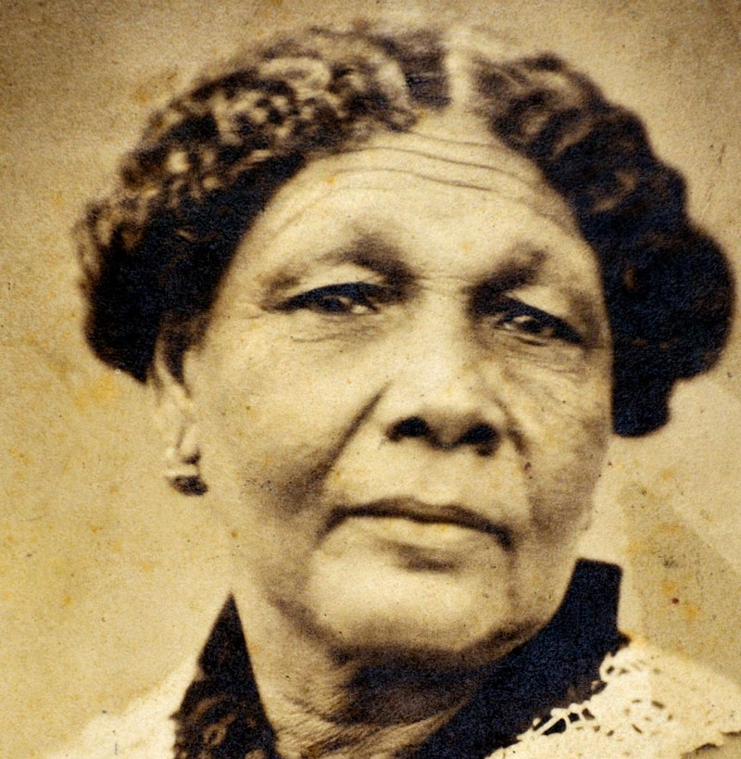
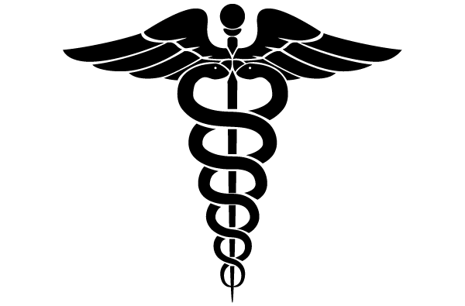
Mary Seacole
Nurse, healer and businesswoman
People who have made a positive change

Slide 2






Where in the World?
You will see different locations linked to Mary Seacole, write down the countries that you see on the following page.
Look out for the flags to help you!
The Bahamas
Haiti
Cuba
Crimea
United Kingdom
Jamaica
People who have made a positive change

Slide 3
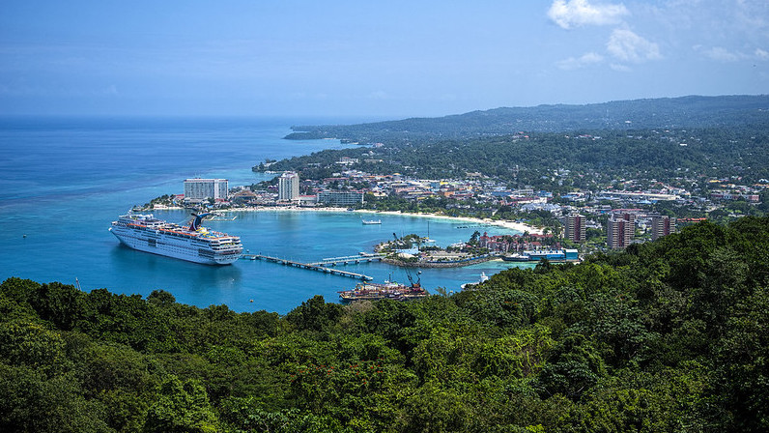
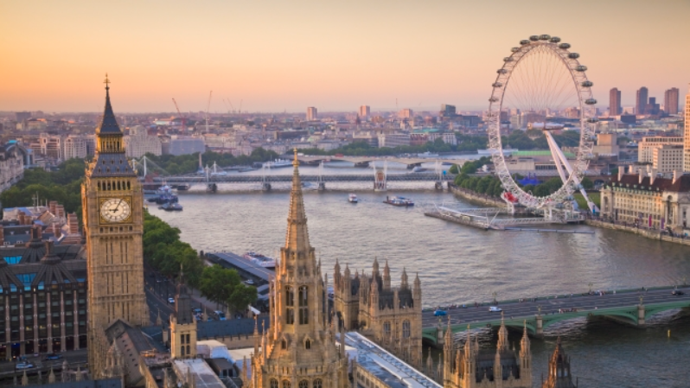
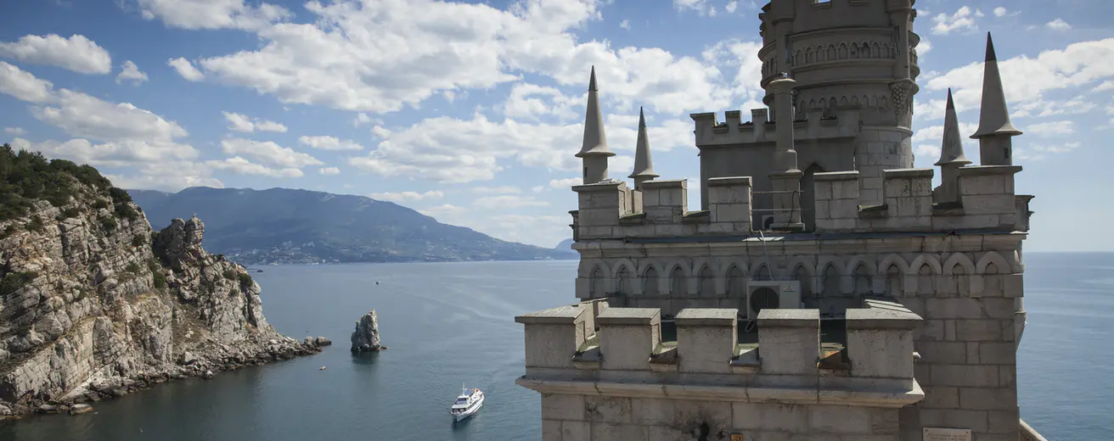
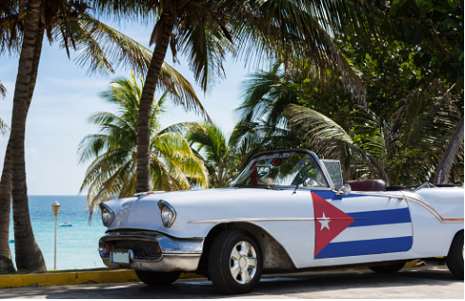

Where in the World?
People who have made a positive change

Slide 4
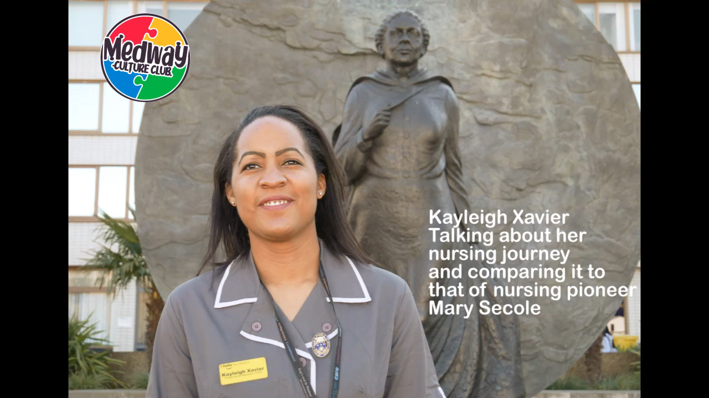
NHS Clinical Nurse: Kayleigh Xavier
People who have made a positive change

Slide 5
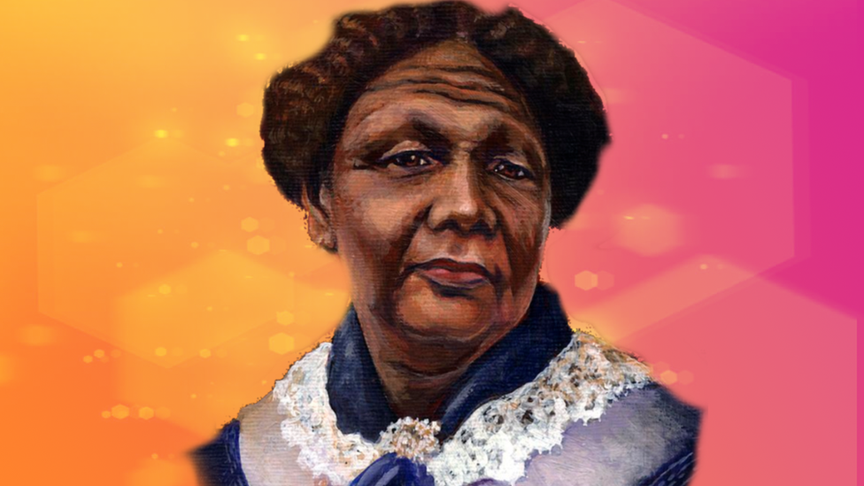
Who is Mary Seacole?
Mary Seacole was born in November 1805 in Kingston, Jamaica.
She was born to a black Jamaican mother and a white Scottish father.
Her dad’s name was James Grant and he was an Army officer.
Mary had two siblings - Louisa and Edward.
People who have made a positive change

Slide 6
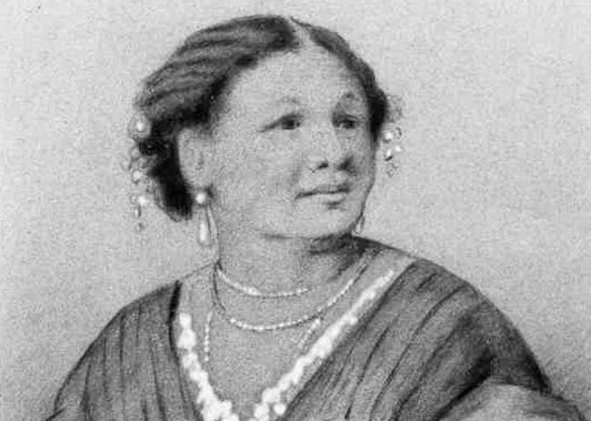
Who is Mary Seacole?
Mary Seacole’s mother was well-known and respected in Kingston, Jamaica.
She was a healer and taught Mary about traditional medicines.
She ran a lodging house called Blundell Hall.
As a child, Mary enjoyed school and practiced medicine on her dolls, dogs and cats.
People who have made a positive change

Slide 7
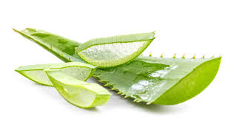
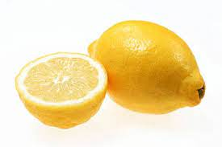
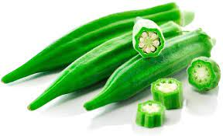
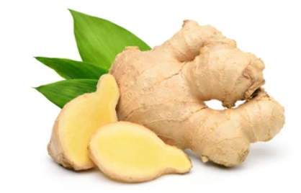
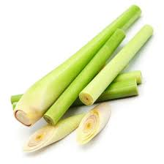
What do your parents give you when you are not feeling too well?
Name the herb and match its properties
Aloe Vera
Helps with upset stomach.
Helps heal cuts and wounds.
Lemon
Boiled to help with a fever.
Okra
Helps to heal coughs.
Ginger
Helps to heal boils.
Lemongrass
People who have made a positive change

Slide 8
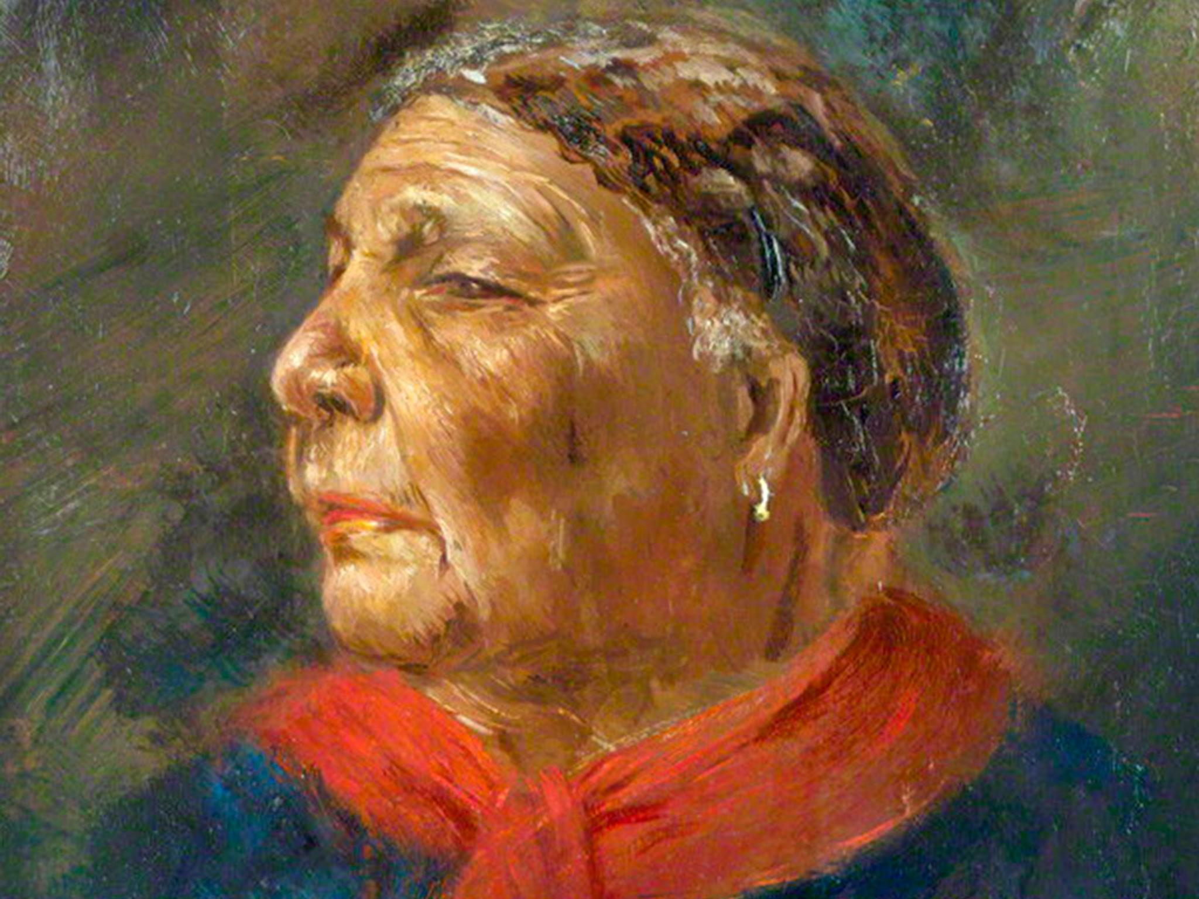
Who is Mary Seacole?
She married Edwin Seacole on 10th November 1836 and was widowed 8 years later in 1844, after she did her best to nurse him.
The Crimean War lasted from October 1853 until February 1856. It was fought by a coalition including Britain, against the Russian Empire.
Mary travelled to England and approached the British War Office, asking to be sent as an army nurse to the Crimea to work alongside Florence Nightingale. They said no
People who have made a positive change

Slide 9
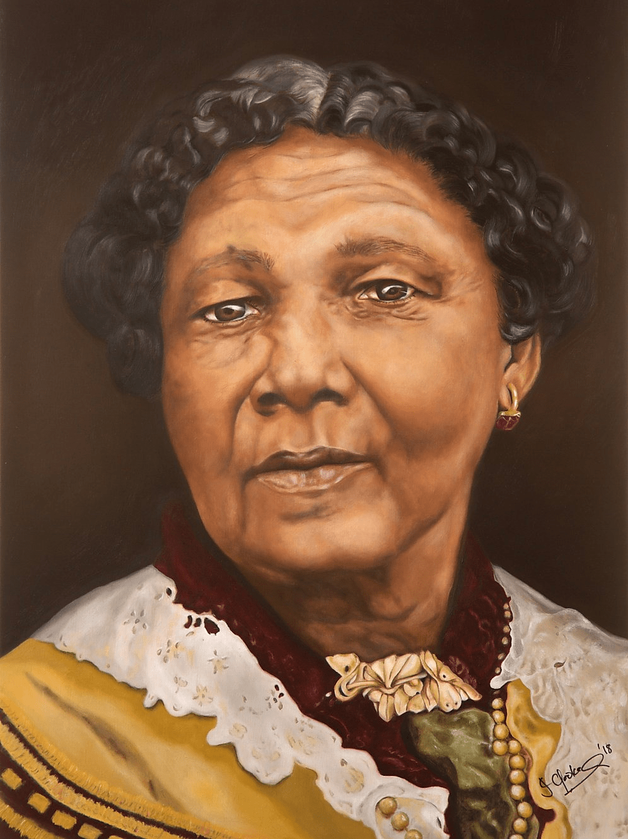
Who is Mary Seacole?
When the war ended, Mary went back to Britain with very little money. Soldiers wrote letters to newspapers, praising what she had done.
She published her autobiography in 1857.
She died in London in 1881.
In 2004, she was voted the Greatest Black Briton.
People who have made a positive change

Slide 10
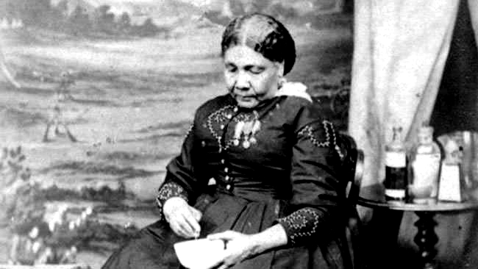
Who is Mary Seacole?
People who have made a positive change
This is the last picture of Mary Seacole, taken around 1873

Slide 11
Matching Activity of her life
Mary travelled to England and stayed with relatives for a year to learn about European medicine.
1818 (Aged 12)
Mary returned to Kingston Jamaica.
1821
Mary helped to run a boarding house for sick or injured soldiers.
1823
Mary came back to London and stayed for two years.
1825
Mary travelled to Cuba, Haiti and the Bahamas.
1826
People who have made a positive change

Slide 12
Answer Sheet 1
Jamaica
United Kingdom
Crimea
Cuba
People who have made a positive change

Slide 13
Answer Sheet 2
Mary travelled to England and stayed with relatives for a year to learn about European medicine.
1821
Mary returned to Kingston Jamaica.
1826
Mary helped to run a boarding house for sick or injured soldiers.
1818 (aged 12)
Mary came back to London and stayed for two years.
1823
Mary travelled to Cuba, Haiti and the Bahamas.
1825
People who have made a positive change

Slide 14
Answer Sheet 3
Ginger
Helps with upset stomach.
Helps heal cuts and wounds.
Aloe Vera
Boiled to help with a fever.
Lemongrass
Helps to heal coughs.
Lemon
Helps to heal boils.
Okra
People who have made a positive change

Slide 15


Funded by The National Heritage Lottery
© 2021 Medway Culture Club. For Medway African and Caribbean Association only.
Please do not share without prior consent. Thank you.
People who have made a positive change

