Slide 1


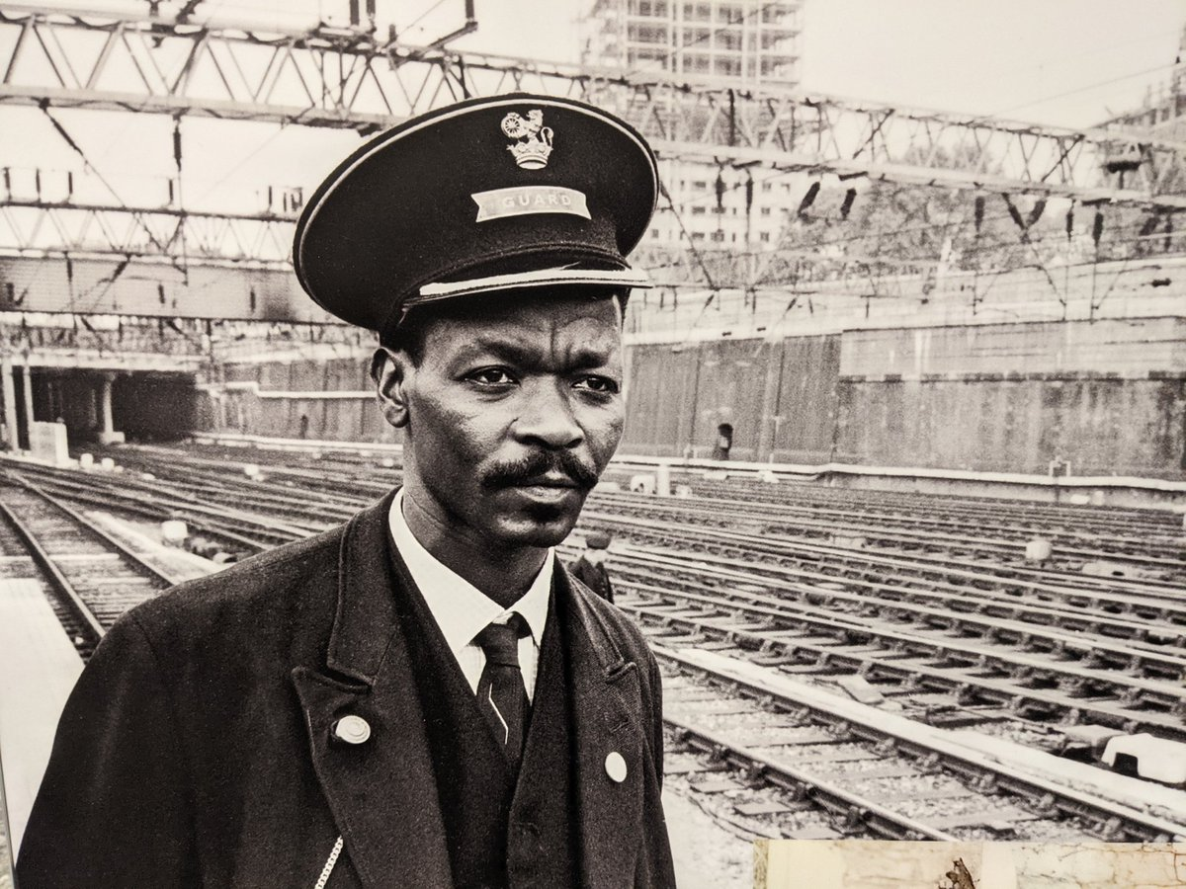

Asquith Xavier – An Unsung Hero
People who have made a positive change
People who have made a positive change

Slide 2
The Colour Bar at Euston Station
In the 1950s, employees at Euston station voted to ban non-white workers from jobs that involved coming into contact with the public. This meant Black and Asian workers could be cleaners but could not be considered for jobs such as ticket inspectors and guards.
Asquith who was working at Marylebone Station applied for a promotion at Euston Station but was rejected because of the colour of his skin.
Asquith then faced a choice:
Give up on his ambition and accept the colour bar
Fight for the right to be considered for a job based on his merits
Which option did he choose?
If you were in Asquith’s position, which option would you have chosen?
People who have made a positive change

Slide 3
Who is Asquith Xavier?
Asquith Camile Xavier (18th July 1920 – 18th June 1980) was a West Indian-born Briton.
He ended a colour bar at British Railways in London by fighting to become the first non-white train guard at Euston railway station in 1966.
He was born on the island of Dominica in the West Indies, then a British colony.
He was a part of the Windrush generation who came to Britain to help rebuild the weakened economy following WWII.
Asquith left Dominica and docked in Southampton on 16th April 1958.
People who have made a positive change

Slide 4
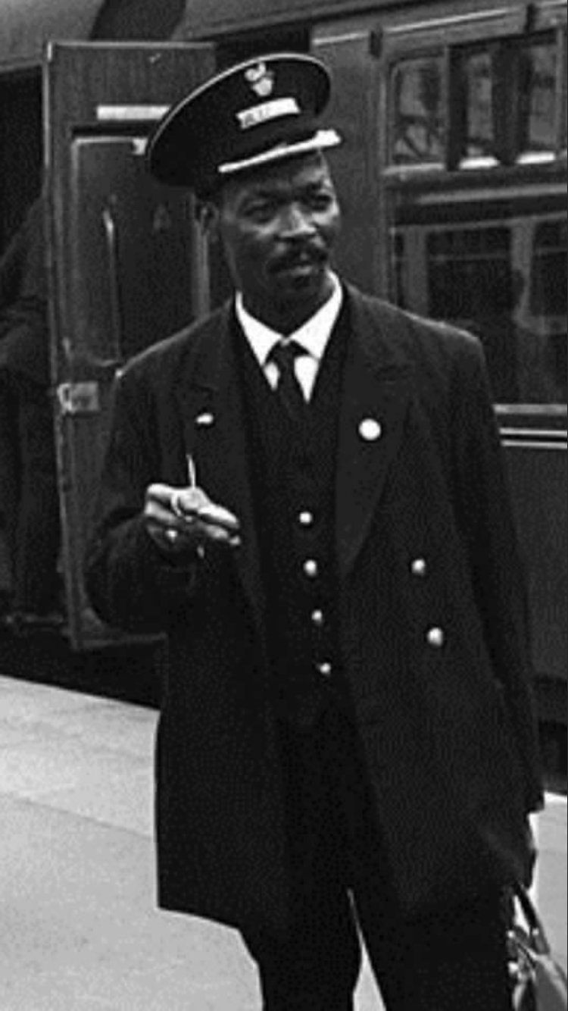
Who is Asquith Xavier?
Settling in Paddington, West London, he worked with British Rail as a porter before progressing to guard at Marylebone depot.
In 1966, he applied for a transfer to London Euston station.
He was denied the job due to an unofficial “colour bar” which operated at the station, excluding Black people from working in customer-facing roles.
Unhappy with this decision, Asquith campaigned to end the racial discrimination practiced by British Rail.
People who have made a positive change

Slide 5
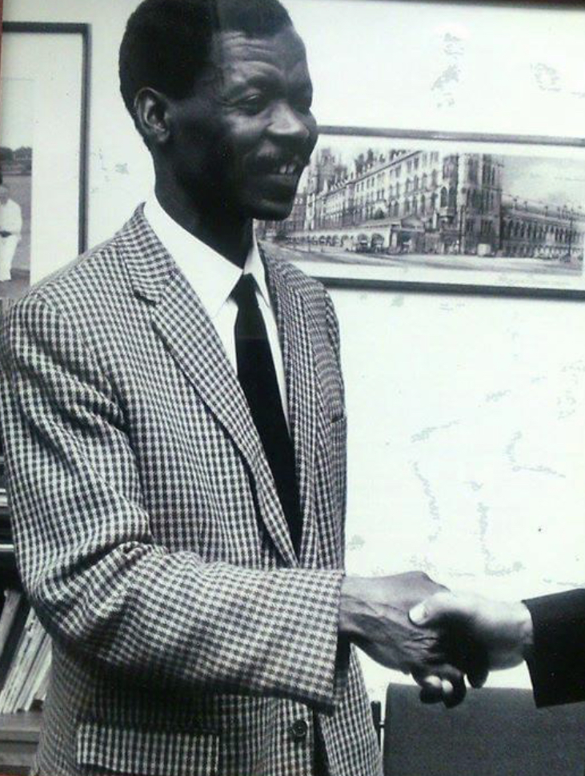
Who is Asquith Xavier?
The first Race Relations Act was passed in 1965 making it illegal to discriminate on the grounds of colour, race, ethnic or national origins in public places.
But the railways were not considered public and somehow Asquith’s story gained traction.
His hard-fought battle meant that on August 15 1966, he became the first non-white guard to be employed at Euston Station
In 1972, Asquith and his family moved from London to Chatham, Kent
People who have made a positive change

Slide 6
Matching Activity of his life
What year was Asquith Xavier born?
1920
1930
1940
Where was he born?
Jamaica
Dominica
Trinidad
What year did he travel to England?
1938
1948
1958
Where did he become the first black guard?
Paddington
Euston
Victoria
Where did Asquith move to in Kent
Gravesend
Chatham
Rochester
People who have made a positive change

Slide 7

Asquith Xavier – Play Video
People who have made a positive change

Slide 8
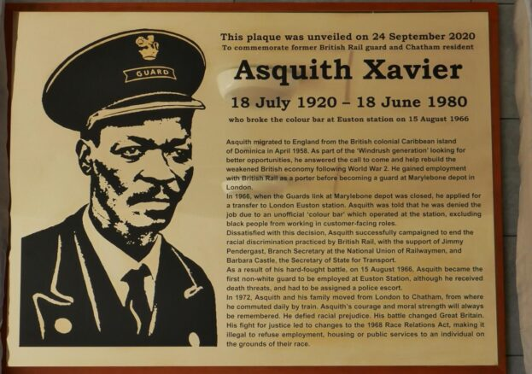
Plaque at Chatham Train Station
People who have made a positive change

Slide 9

The Feelings of an Unsung Hero
How do you think
Asquith felt to fight
this battle alone?
People who have made a positive change

Slide 10

What is a Trailblazer?
Choose the definition that best explains the word “Trailblazer”.
A person who is the leader.
The first person to do something new.
A person who follows what someone else has done.
A person who is the first to do something.
People who have made a positive change

Slide 11

Trailblazer
Does Asquith qualify as
A trailblazer?
People who have made a positive change

Slide 12
Answer Sheet 1
What year was Asquith Xavier born?
1920
Where was he born?
Dominica
What year did he travel to England?
1958
Where did he become the first black guard?
Euston
Where did Asquith move to in Kent
Chatham
People who have made a positive change

Slide 13
Answer Sheet 2
Choose the definition that best explains the word “Trailblazer”.
A person who is the leader. 
The first person to do something new. 
A person who follows what someone else has done. 
A person who is the first to do something. 
People who have made a positive change

Slide 14
© 2021 Medway Culture Club. For Medway African and Caribbean Association only.
Please do not share without prior consent. Thank you.
People who have made a positive change

